Slide 1


Video Data Acquisition, Logging, Archiving
Dwight Coleman
Director, Inner Space Center, URI-GSO

Slide 2
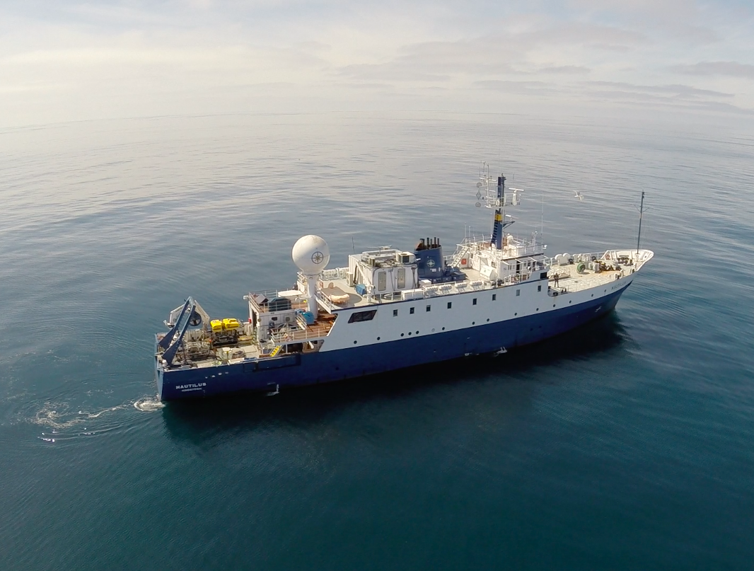
E/V Nautilus

Slide 3
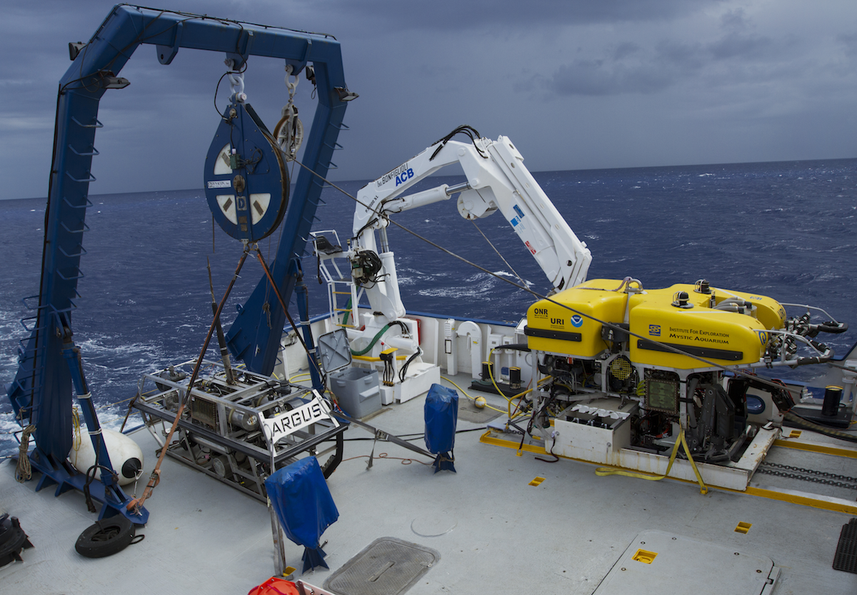
ROV Hercules and Towsled Argus

Slide 4
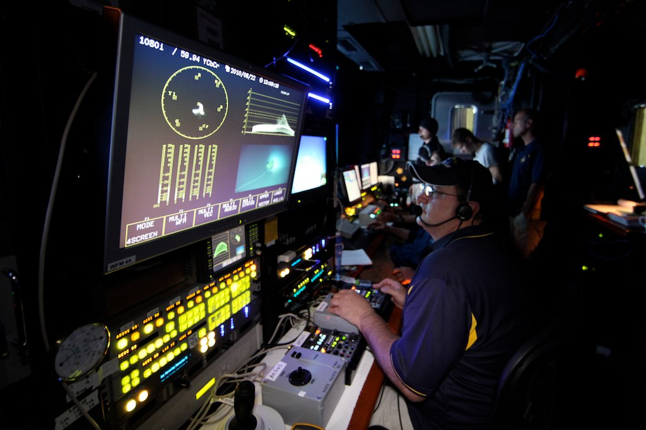
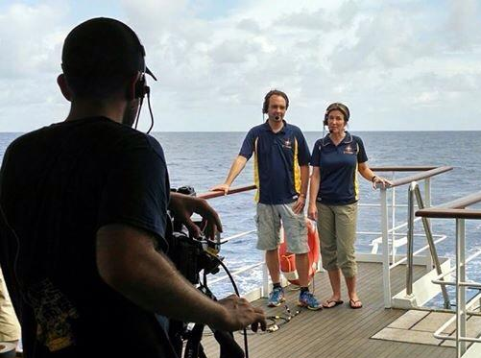
Underwater Video Systems
E/V Nautilus – Hercules and Argus
Insite Pacific Zeus Plus HDTV Cameras
1080i raw HD digital video
Omneon Mediadecks – 4 channels
Sony XDCam NLE 50 Mbps essence
MOV wrapper
Time code and 2 channels audio L/R
Telepresence and Outreach
Topside video data collection
Live streaming ship-to-shore interactions
Omneon Mediadeck recordings on shore
of vehicle dives, Hercules only
Dive highlights video production
Onshore - Resource Space
for video highlights, samples

Slide 5
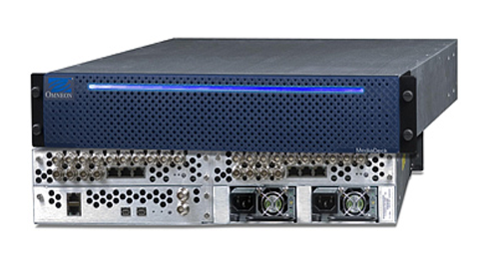
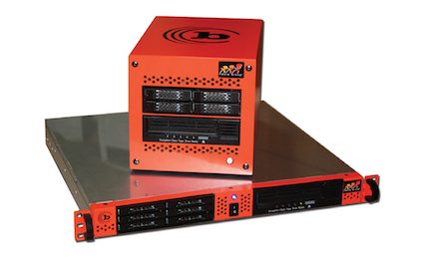
Shipboard Video Data Acquisition
Omneon Mediadecks – 6 Tb storage per system, 12 Tb total – about 250 hours of HD
Log 5 minute long files (primarily due to 4 Gb FAT32 file size limitation)
File naming convention contains metadata:
NA069_H01_150913_23095022.mov
CruiseID_CameraID_Date_Time_Frame
Shipboard Logging
Text based – event logs, IM/chat logs, navigation files, vehicle sensor data
Video still captures (frame grabs)
Shipboard Video Data Archive
Tolis Group – BRU System
LTO6 tapes - 2.5 Tb of uncompressed video - ~70 hours
2 simultaneous copies burned – 1 onboard, 1 to ISC
5-10 tapes per cruise leg carried to ISC, nothing deleted
Omneons scrubbed after ISC data QC verification

Slide 6
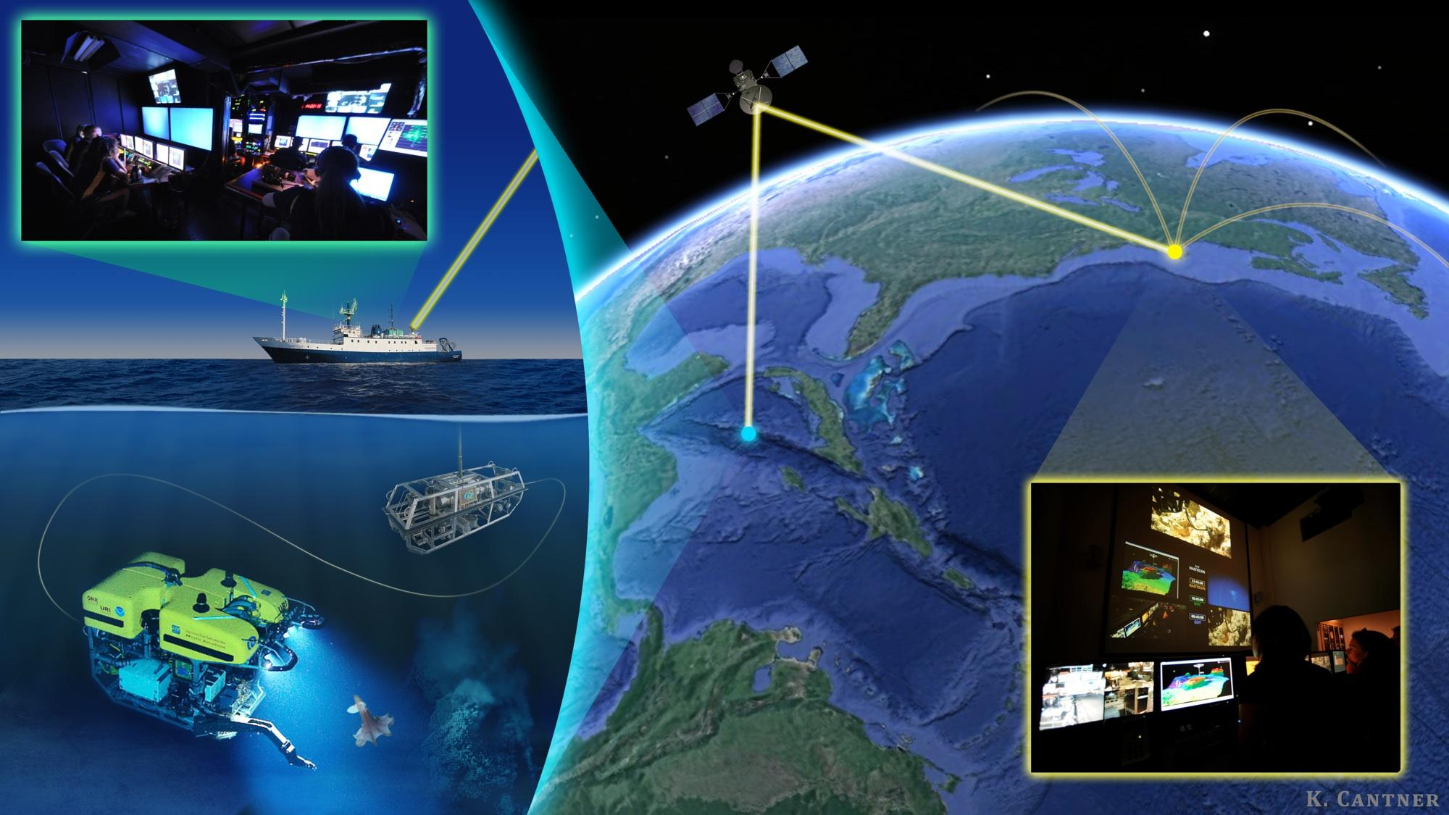
Inner Space Center - Video Data Management Workflow
Shore-based BRU LTO archive system – tapes loaded and verified, data QC
Every tape verified, ingested into archive BRU database, logged, confirm w/ ship
If data is missing or corrupted, contact ship for originals and/or check
telepresence recordings
OET has a video data request form for additional copies, handled case-by-case
Request comes in for data copies, figure out time and effort, check on funding
Tape gets loaded, data gets written to RAID staging drives or directly to media for
delivery, depending on number of required copies
Process takes about 2 weeks per cruise tape set
Video Requests
Approval case by case, production use
If we’re lucky, request contains CruiseID,
Date/Time, and/or geographic info
Scan through event logs and/or captures
Pull video – stage – post or send
Copyright / terms of use / fee structure

Slide 7
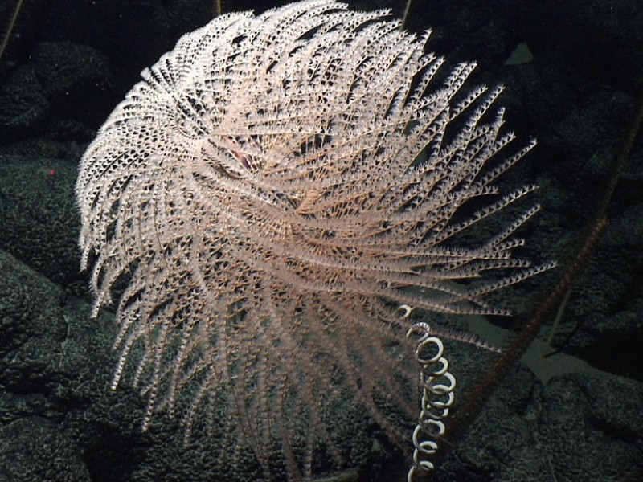
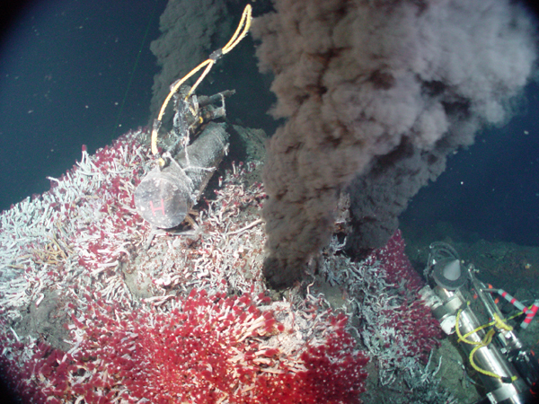
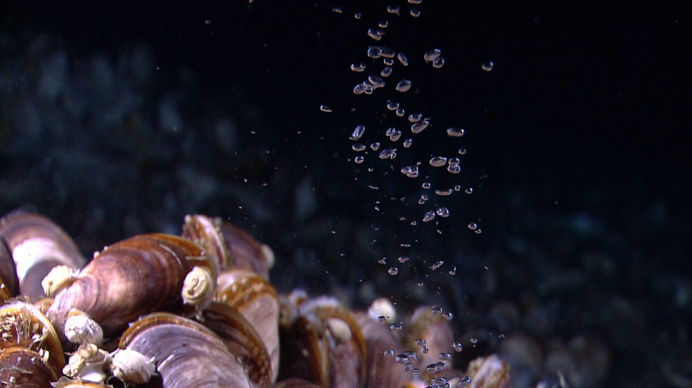
Biggest Challenges
Failing equipment onboard ship and at ISC
Omneon Mediadecks need to be replaced
Metadata standards – implementation
Searching for footage quickly and easily – need for
searchable databases, low res proxies
Dealing with the enormous volumes of data that
expand each year
Integrating topside expedition video and stills as data
Time it takes to read from or write to tapes
Time it takes to make data copies (USB or Network)
Data discovery and data rescue
Expense of video server and archiving equipment
Expense of equipment maintenance plans
Expense of personnel to manage data

